Slide 1
Managing a Successful Computing Project including user experience features in Community Portal
Module Project
Module: Managing a Successful Computing Project
Course: : Managing a Successful Computing Project for including user experience features in an Existing Community Portal (Project Management Plan)
Start Date :27/10/2022
End Date :27/10/2022
Submission Date :28/10/2022
Learner Name : Chathushi Jayarathna
Enrollment ID :
Presentation Date :

Slide 2
Contents
Document History
Version Number | Effective Date of release | Summary of Included Changes | Author
1 | 4th March 2016 | First Edition | Satya CVS
2 | 16th Oct 2017 | Changed for Module 6 | Shrinivas K R

Slide 3
Contents
Contents
Contents
S. No. | Description
01 | Principles of Problem Management
02 | Problem Management Example
03 | Tools, Process & Technologies
04 | Investigation & Diagnosis
05 | Explain Prioritization
06 | Problem Management Solution
07 | Systems you will Implement
08 | Project Milestones & Tasks
09 | Milestone Feedback & Action taken
10 | Modifications Made based On Feedback
11 | Project Results
12 | Proposed Improvements

Slide 4
1. Principles of Problem Management
Principles of Problem Management
Problem Identification A problem may be detected within an incident file or an analysis of an existing incident. When the motive for a prevalence or collection of incidents is uncertain, it's far most probable. In an effort to prevent future service interruptions, proactive problem detection could be very critical.
Problem Logging It is important to document troubles for later reference. Details about the problem, inclusive of its kind, description, associated occasions, category, consumer records, repute, resolution, and closure, need to be recorded. To tag recognized problems and manage them in a database, these facts are crucial.
Problem Investigation An investigation into the foundation cause of a problem additionally relies upon the severity and urgency of the problem. Commonplace investigation strategies encompass reviewing the regarded Error Database (KEDB) on the way to discover similar problems. Then, the great direction of motion is decided to solve the problem.

Slide 5
1. Principles of Problem Management
Principles of Problem Management
Resolution
As soon as resolved and the answer is determined, it is able to be implemented the usage of a standard exchange procedure. it's also important to make sure of service recovery. With the purpose to repair the problem permanently, a new change has to be raised. Alternate control handles the assessment, planning, and execution of changes.
Review At some point at this level, it is critical to study the resolution of the problem, and its effect on the enterprise as well as perform a risk analysis. This guarantees that the problem control procedure is executed easily and always progressed for destiny. This overview is recorded as well as shared with relevant groups and people.

Slide 6
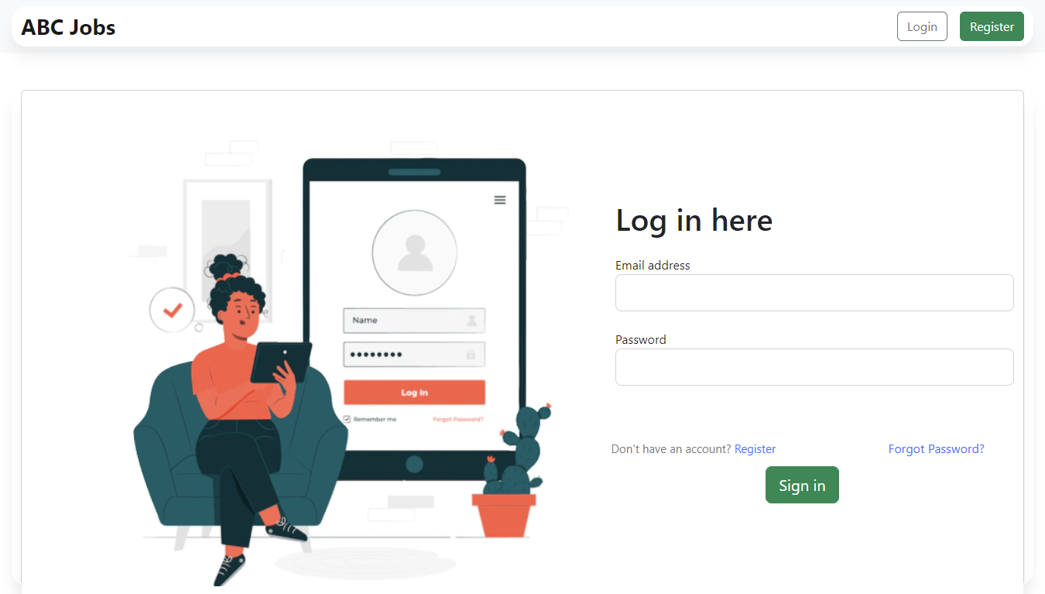
2. Problem Management Example
Problem Identification
When the user clicks on the forgot password link on login page,
the user will be redirected to the index page instead of the forgo password page

Slide 7
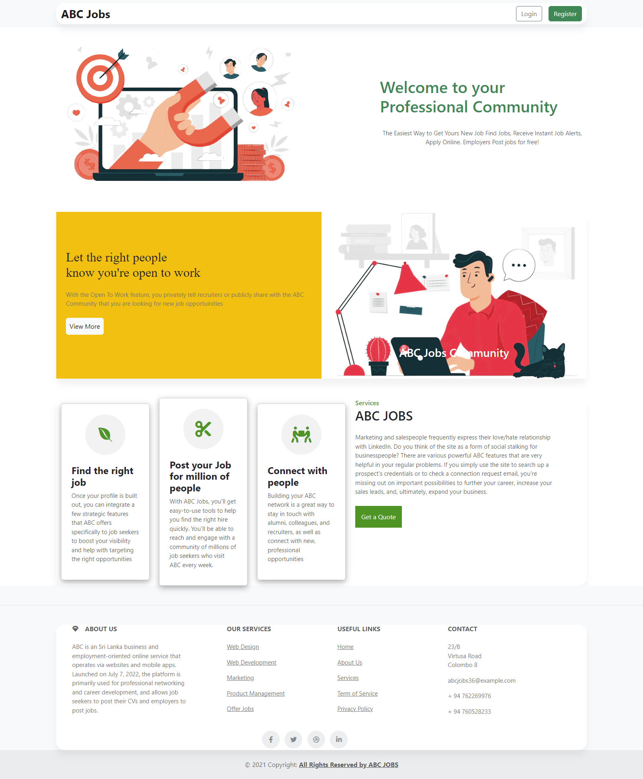
2. Problem Management Example
Problem Investigation It likely because mapping mentioned in the controller was wrong
Problem Logging
No | Class | Problem
01 | MainController.java | Wrong Mapping “@RequestMapping("/forgotpassform") public String index() { return "index"; }”
Resolution
Change the path in MainController.java as
@RequestMapping("/forgotpassform")
public String forgotpassform() {
return "forgotpassform";
}

Slide 8
3. Tools, Process & Technologies
Tools, Process & Techniques
Problem Identification
Techniques = Issue Tracking System
Tool = Excel Sheet
Using an Excel sheet to make a tracking document template is an important tool for problem identification.
Process:
Receive a problem report
Verify the problem
Logging the problem issue
Resolving the problem
When it’s resolved, it will be remarked as resolved in the issue tracking system

Slide 9
3. Tools, Process & Technologies
Issue Identification and Tracking Document
Created By: |  |  | Chathushi |  | Last Update By: Chathushi
Date Created: |  |  | 19 October 2022 |  | Last Revision Date: October 2022
Issue No. | Issue Description | Issue Type | Identified By | Date Identified | Issue Assigned To | Target Resolution Date | Priority | Status | Date Resolved | Resolution Description
1 | Thank you, page is not showing, | Technical Issues | Software Tester Team | 19 October 2022 | Software Development Team | 20 October 2022 | Low | Resolved | 19 October 2022 | Correcting the letters from code in MainController
2 | When the user clicks on forgot password link on login page, the user will be redirected to the index page instead of forgot password page | Technical Issues | Software Tester Team | 19 October 2022 | Software Development Team | 20 October 2022 | Medium | Resolved | 19 October 2022 | Correcting the code in MainController.java
3 | User registration data is not stored in database | Technical Issues | Software Tester Team | 19 October 2022 | Software Development Team | 22 October 2022 | High | Resolved | 21 October 2022 | Correcting the code in controller and dao class

Slide 10
3. Tools, Process & Technologies
Problem Investigation
Techniques = Root Cause Analysis
Tool = Fish Bone
The Fishbone is an excellent visualization tool for discovering multiple root cause. It shaped like the skeleton of a fish, with the head on the right side being the effect of the problem and the possible causes shown as fish spine on the left
Process:
Define the problem statement
Find the root cause
Fix the root cause
Finalize solution

Slide 11
3. Tools, Process & Technologies
Problem Resolution
Techniques = Known Error Database
Tool = Excel Sheet
Using an Excel sheet to make a tracking document template is an important tool for problem identification.
Process:
Adding known error records
Create a known error record with the symptoms and resolution details
Accessing known error records
Search KEDB and apply fix
Deleting known error records
Permanent solution implemented

Slide 12
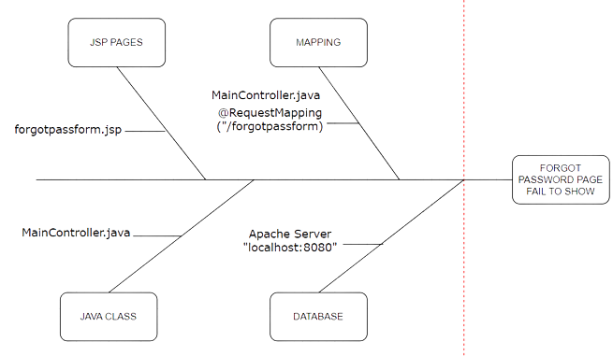
4. Investigation & Diagnosis
Investigate the problem
We narrow the problem causes into the Controller and Security Configuration class

Slide 13
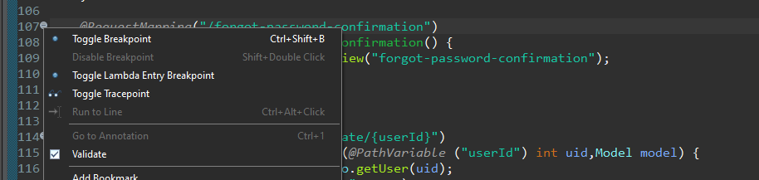
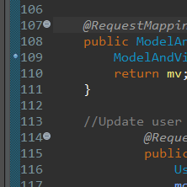
4. Investigation & Diagnosis
Diagnose the problem
Identify the root of the problem by removing the error (Debugging)
Step 1 – Set Breakpoints
Figure 10:Screenshot of debugging in eclipse step 1
Breakpoint: A blue circle should then appear next to the line:

Slide 14
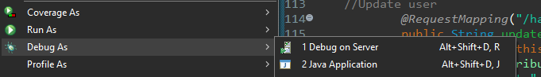
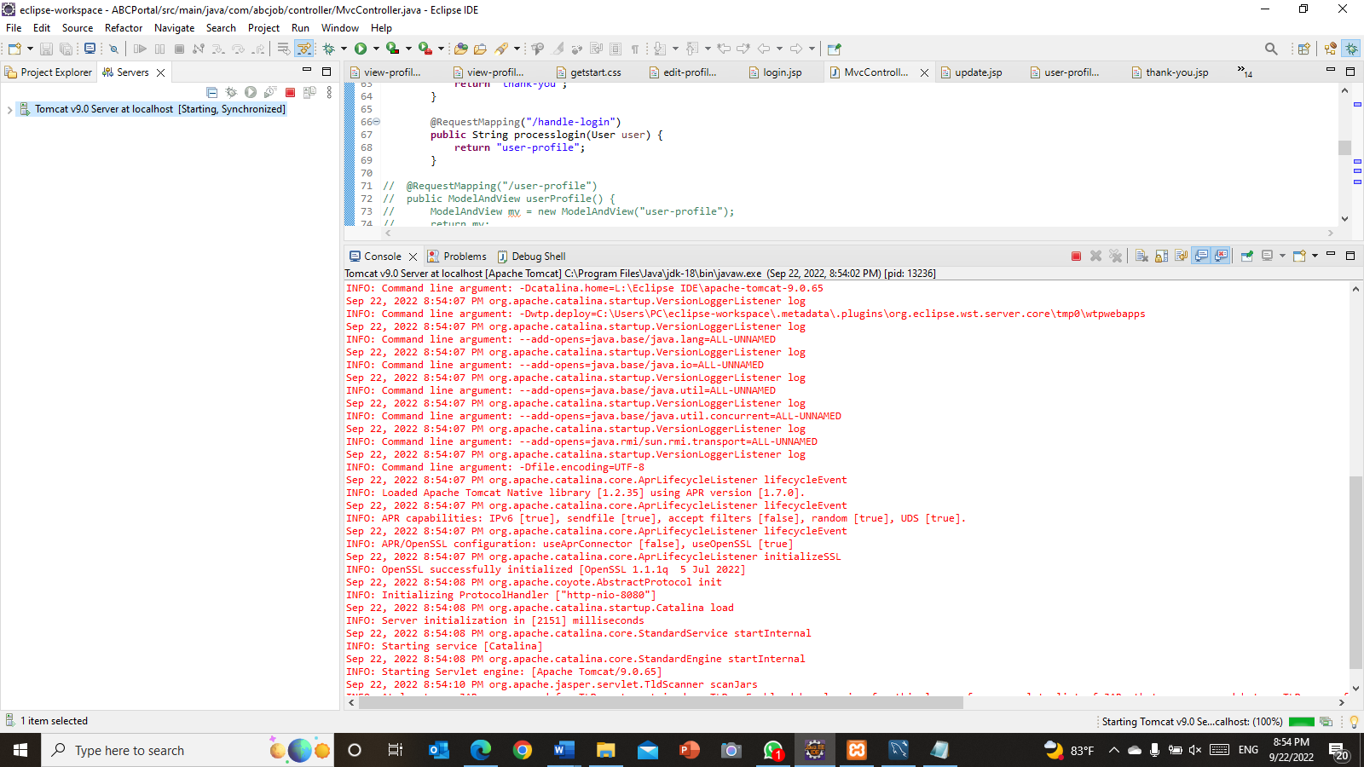
4. Investigation & Diagnosis
Step 2 – Start the program in Debug mode
(Right click on project→Debug as→Debug as server)
Step 3 – Showing debugger details in the console

Slide 15
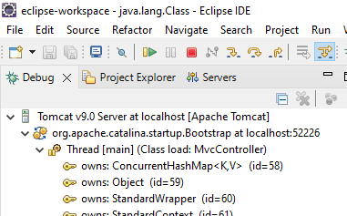
4. Investigation & Diagnosis
Step 4 - Controlling the program execution
The call stack indicates the parts of the program which can be currently executed and the way they relate to
each other. The present-day stack is displayed inside the Debug view

Slide 16
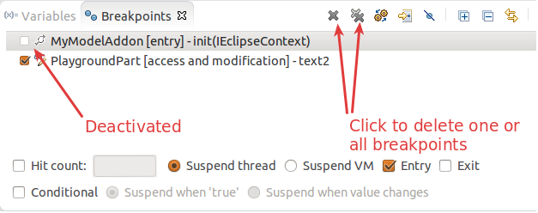
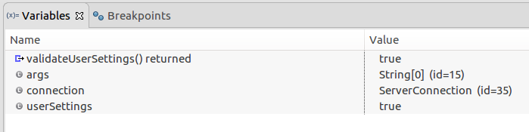
4. Investigation & Diagnosis
Step 6 -Evaluating variables in the debugger
The variables view shows fields and nearby variables from the contemporary executing stack
Step 5 - Breakpoints view and deactivating breakpoints

Slide 17
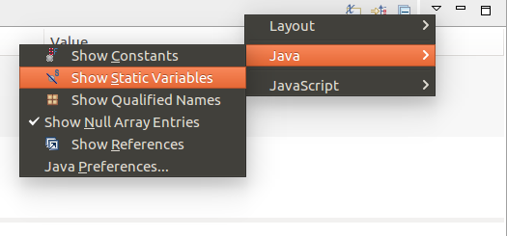
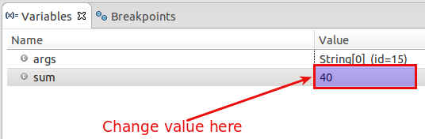
4. Investigation & Diagnosis
Step 7 – Use the drop-down menu to display static variables
Step 8 - Changing variable assignments in the debugger

Slide 18
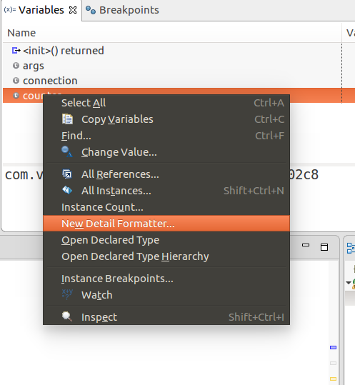
4. Investigation & Diagnosis
Step 9 -Controlling the display of the variables with detail formatter
4. Investigation & Diagnosis
Figure 18:Screenshot of debugging in eclipse step 9

Slide 19
5. Explain Prioritization
Prioritize and Categories problems:
Tier 1: Low-priority issues
Thank you, the page is not showing,.
Tier 2: Medium priority issues
When the user clicks on forgot password link on the login page, the user will be redirected to the index page instead of forgot password page
Tier 3: High-Priority Issues
User registration data is not stored in a database

Slide 20
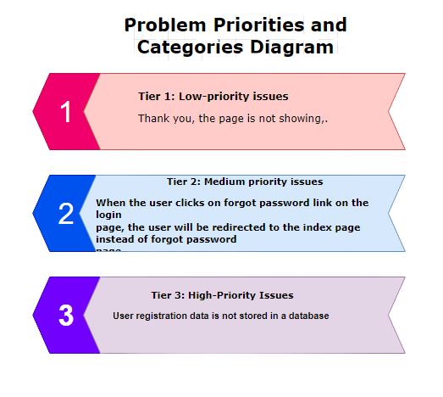
5. Explain Prioritization
Problems Categories Diagram

Slide 21
6. Problem Management Solution
Problem Management Solution
Solution for forgot password page display data failure
Using the fishbone tool, we discover the root cause (root cause analysis)
Test the code once more
Add the problem to regarded error database
Debug the code using breakpoints
Thinking of the solution for the root cause
Regulate the root cause problem
After rerunning the application on debug mode
If the problem is resolved, update the known error database

Slide 22
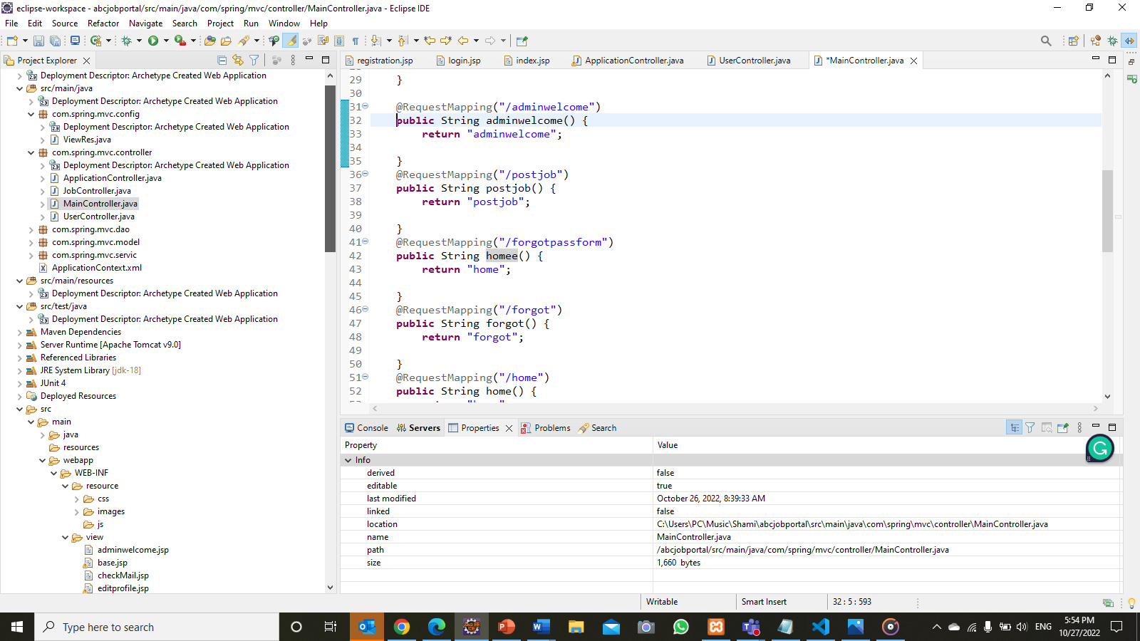
6. Problem Management Solution
Before fixing the Issue

Slide 23
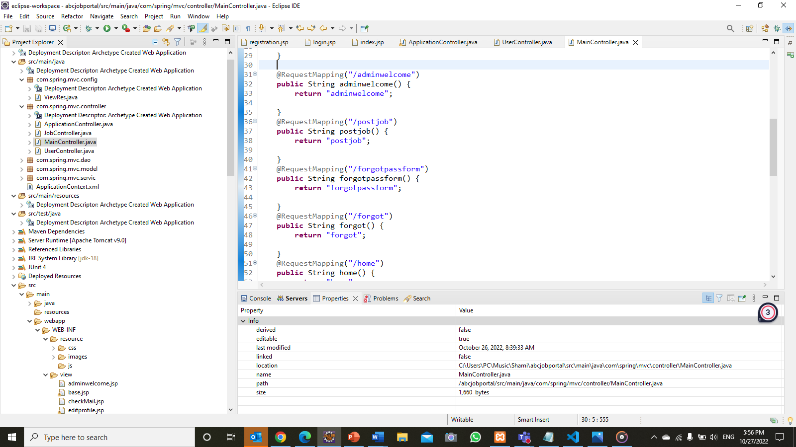
6. Problem Management Solution
After fixing the Issue

Slide 24
6. Problem Management Solution
Issue No. | Issue Description | Issue Type | Root Cause | Workaround | Status | Date Resolved
1 | Thank you, page is not showing, | Technical Issues | In getmapping method or uppercase lowercase mis correction | Correcting the letters from code in MainController.java | Resolved | 19 October 2022
2 | When the user clicks on forgot password link on login page, the user will be redirected to the index page instead of forgot password page | Technical Issues | Wrong mapping in MainController.java class | Correcting the code in MainController.java | Resolved | 19 October 2022
3 | User registration data is not stored in database | Technical Issues | Dao class is not mentioned in controller class correctly | Correcting the code in controller and Dao class | Resolved | 22 October 2022
4 | Attached files not showing in bulk mails | Technical Issues |  |  | Incomplete

Slide 25
7. Systems you will Implement
Apply Job
Users (Software Programmer)
- List Job Page
- Apply Job Functionality
- Apply Job History
- Search Job Functionality
- User Job Page
Admin
- Manage Jobs
- Manage Job Applicants

Slide 26
8. Project Milestones & Tasks
Project Task ID | Project Task Description | Project Milestone ID
1 | Identify problems and develop issue tracking documents | 1
2 | Problem investigation and diagnosis | 1
3 | Problem prioritization | 1
4 | Problem resolution | 2
5 | Creating a known error database | 3

Slide 27
9. Milestone Feedback & Action taken
Project Milestone ID | Milestone Feedback received from Tutor / Learning Facilitator | Action Taken (Yes / No)
1 | Creating fishbone technique with diagram.net | Yes
2 | Change Testing table format | Yes

Slide 28
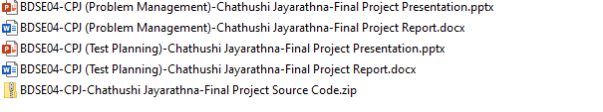
11. Project Results
List evidence of the project Results

Slide 29
12. Proposed Improvements
List of Improvements
Making sure to document the problem management

